Slide 1
Writing Effective Emails
Notes:
Think about the most important email that you’ve ever received. As college freshman, maybe it was your SAT scores, or your college acceptance. Share with someone around you what that email was.
Key characteristics of examples: informative, business in nature, got straight to the point, error-free

Slide 2
A recent UM alumni survey states that EMAILS are the most common form of written communication performed in the workplace.
Notes:
It is amazing how many of my BIG life events were dependent on an email: college acceptance, job offer, waiting for an email back for work approval, scheduling my defense, progressing on a project. Even now, because I often co-teach, there are many situations in which I cannot complete my work until I get an email response.
What day/time gets the BEST response?

Slide 3
Emails Matter
Common in workplace engineering
Versatile for many purposes and contexts
Convenient for global audiences
Typical that formal documents (letter to client or internal memo) are handled electronically

Slide 4

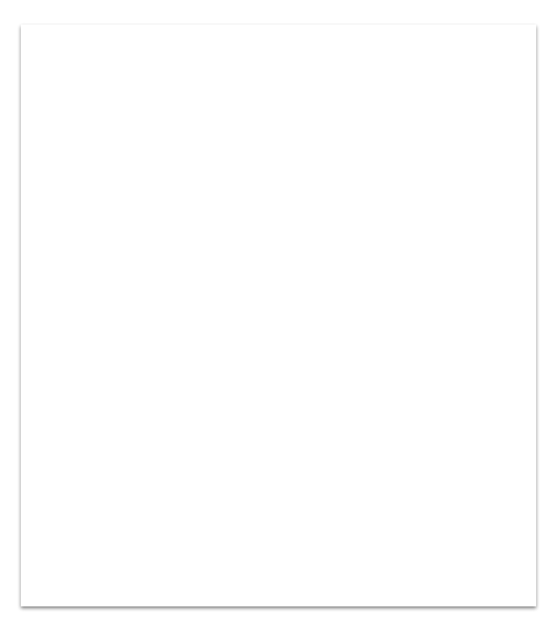
The Basics
Consider the receiver and if email is the best form of communication for your message.
Include a salutation and Close Err on the side of formality and politeness; sign your full name and affiliation
Keep it brief Chunk information into short and specific units; create white space
Proofread Edit; typos can be confusing

Slide 5
Get right to the point, early in your email.
State your purpose in the subject line and first paragraph.
Notes:
Why is this important? Think back to your most important email...

Slide 6
Make information accessible
Include an informative subject line (Include “Request” if you are requesting something!)
Put the main point in the first sentence
Include enough information to set the context of the conversation
Include enough information in your request to make a response possible
State desired outcomes
Keep it short. If longer than two or three short paragraphs, consider:
-Attaching another document
-Listing the topics at the beginning of the message and numbering the topics in the message

Slide 7
Tone and Language Matter
Email does not benefit from intonation, facial expression, or body language
Words reveal your attitude toward your topic and the reader
An email might need longer phrases and more words to show a polite, professional tone

Slide 8
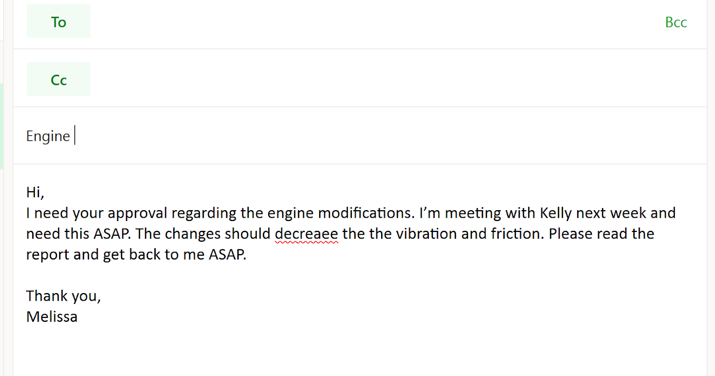
Critique the email above. Is it an effective use of the medium? Why or why not? What should be written instead?
Notes:
There is a lot wrong here; so tell me what is GOOD about this email, first.
Good: Gets right to the purpose
Bad: General subject line, No names, No specific timeline, Typos/errors, Content is not specific, Could be broken up more, Sounds a bit rude at times

Slide 9
Email demands greater formality For most messages, use a salutation: Dear…, Hello..., Use basic courtesy. Say “please" and "thank you.” Start with a positive affirmation. “Thank you for talking with us yesterday…” When you ask for something, use conditional construction. “Would it be possible…” Thank the reader and use a sign-off with your name: Sincerely, Regards, Respectfully, and so on.

Slide 10
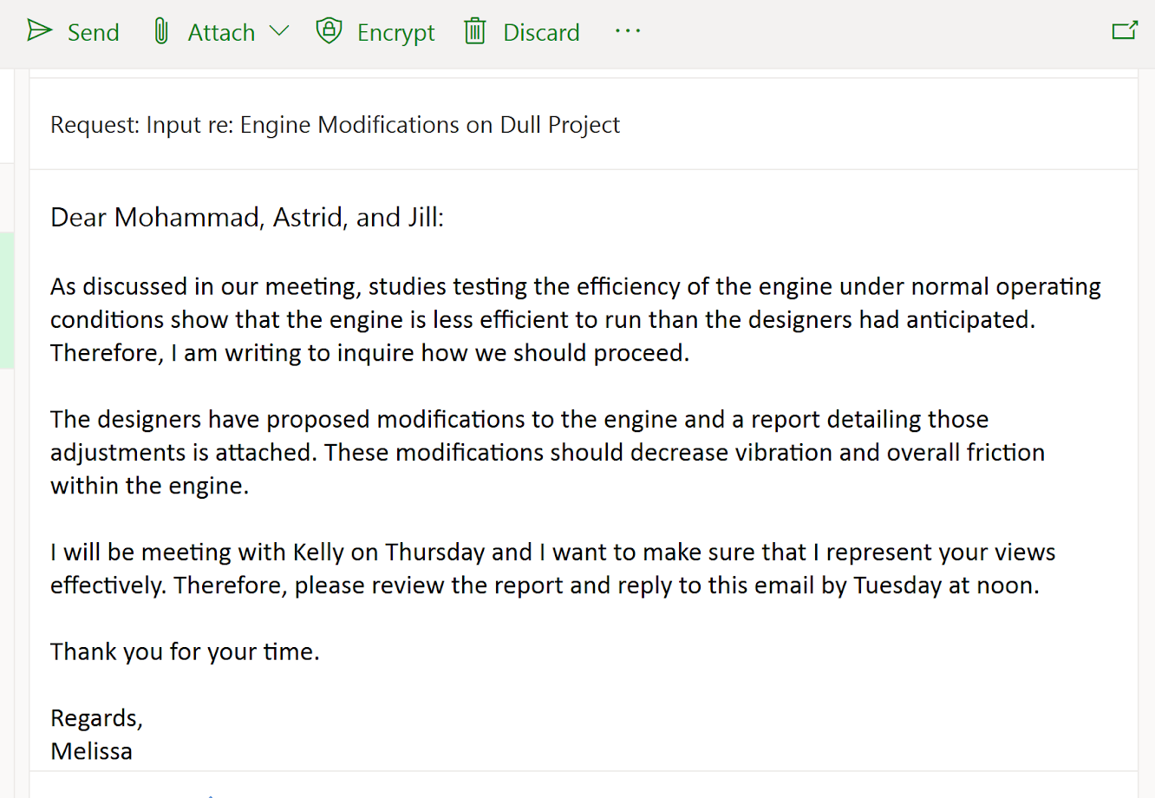
Notes:
Uses names, Gives context, Gets specific, Attached is a report, Gives a direct timeline, Makes them feel included, Polite, White space

Slide 11
Remember
Salutation and Signature Professional and Polite
Paragraphs Concise and Specific
Subject Line and Opener Clear and purposeful
Content Edited and Error-free

